Slide 1

Logstash
Matt Smith
Jan. 31, 2014

Slide 2
Old school logging
When you are told to go look at the logs
cat, tail, grep, sed, awk, …..
regular expressions

Slide 3
What time is it?
1304060505
29/Apr/2011:07:05:26 +0000
Fri, 21 Nov 1997 09:55:06 -0600
Oct 11 20:21:47
020805 13:51:24
110429.071055,118
@4000000037c219bf2ef02e94

Slide 4
Does not scale
More than one server
Many sources within any given server
Different time zones for different servers

Slide 5
System Logs
Consolidate log entries to single location
Now, the problem turns from too little information to one of too much information and too little context
Not everything logs to the system log

Slide 6
Logstash
Open Source Centralized Logging Manager
Apache 2.0 License
Written by @jordansissel

Slide 7
What does Logstash do?
Ships logs from any source
Parse them
Get the right timestamp
Index them
Allows you to search them

Slide 8
How does Logstash get the logs
TCP/UDP
Files
Syslog
Microsoft Windows EventLogs
STDIN
Websocket
zeromq
Plus many more
And it’s extensible (you can write your own)

Slide 9
Parse the input
Json
Csv
Xml
Multi-line (Stack traces from file input)
Regex
Grok (Regex on steroids)

Slide 10
Architecture
Web Interface
Storage & Search
Indexer
Broker
Shipper
Shipper
Broker
Shipper
Shipper
Indexer
Broker
Shipper
Shipper

Slide 11
How can Logstash output data
TCP/UDP
Email
Files
HTTP
Nagios (IT Infrastructure Monitoring tool)
Alerting tools (Hipchat, SMS)
Graphing suites (StatsD, Graphite)

Slide 12
Logstash @ Dreamhost
20k apache events/sec peak
250 million events/day
75gb data/day
160 web servers
7 logstash/elasticsearch servers

Slide 13
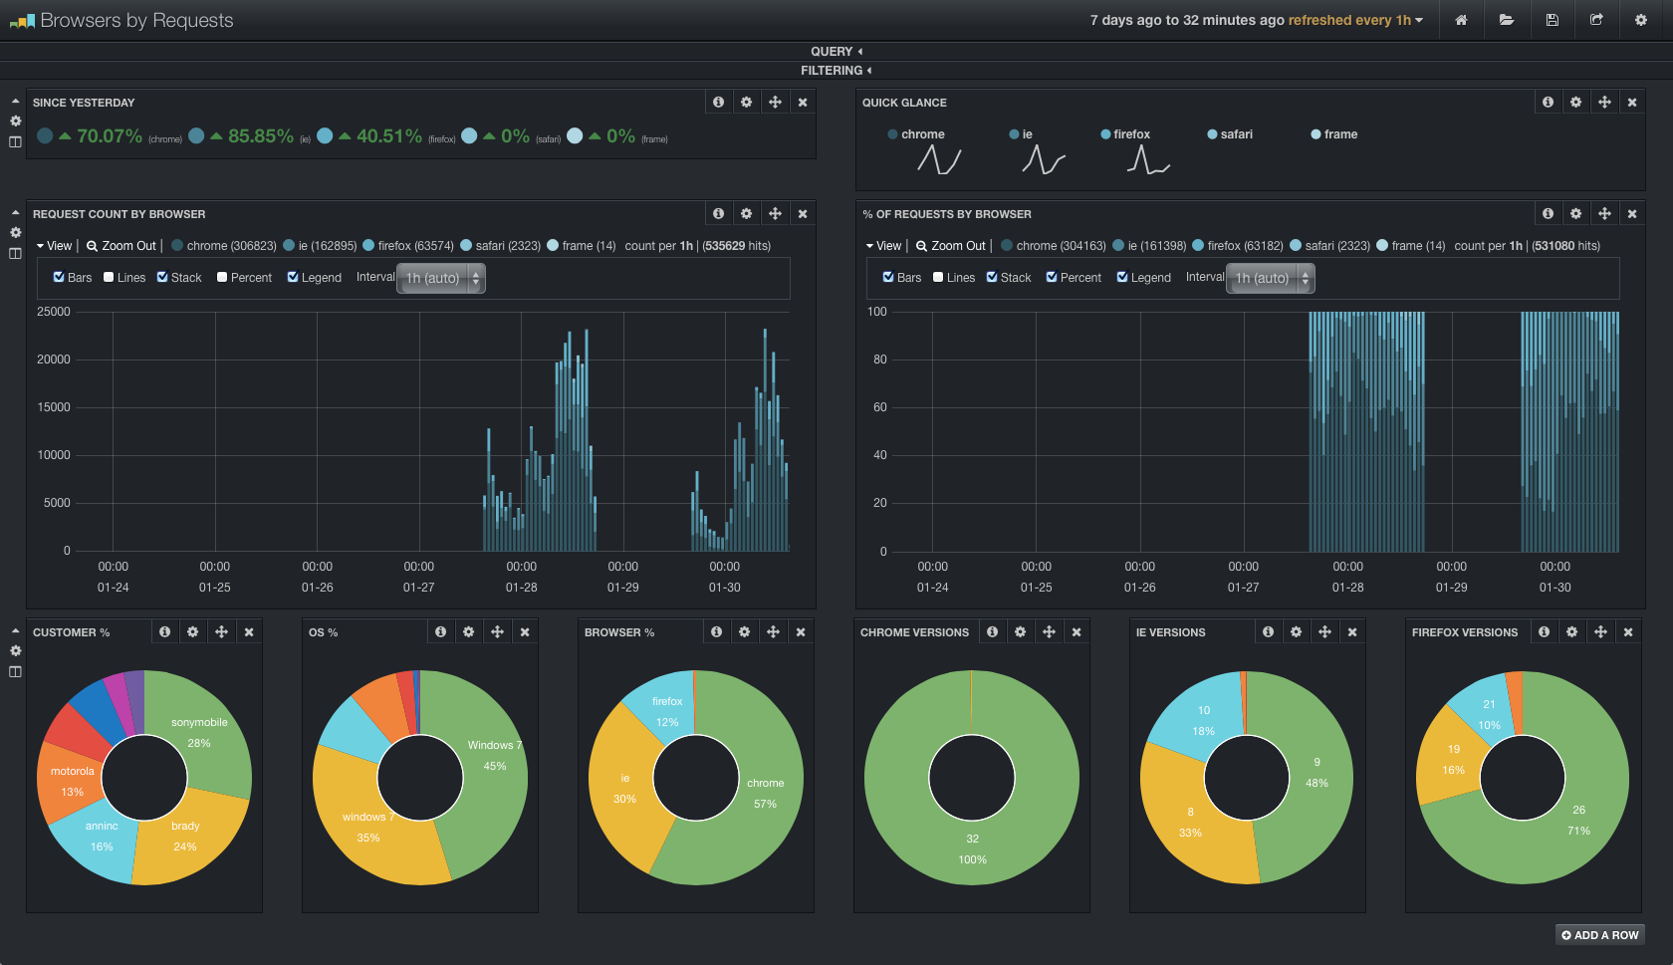

Slide 14
Resources
http://logstash.net
http://www.logstashbook.com ($9.99)
http://github.com/logstash
logstash-users@googlegroups.com
logstash.jira.com
Google

